Slide 1
Imporved Deep Metric Learning with Multi-class N-pair Loss Objective

Slide 2
outline
1. Preliminary: Distance Metric Learning
2. Deep Metric Learning with Multiple Negative Examples
- Learning to identify from multiple negative examples
- N-pair loss for efficient deep metric learning
3. Experimental Results

Slide 3
Preliminary: Distance Metric Learning
- contrastive loss

Slide 4
Preliminary: Distance Metric Learning
- triplet loss

Slide 5
Preliminary: Distance Metric Learning
- contrastive loss

Slide 6
Preliminary: Distance Metric Learning
- triplet loss

Slide 7
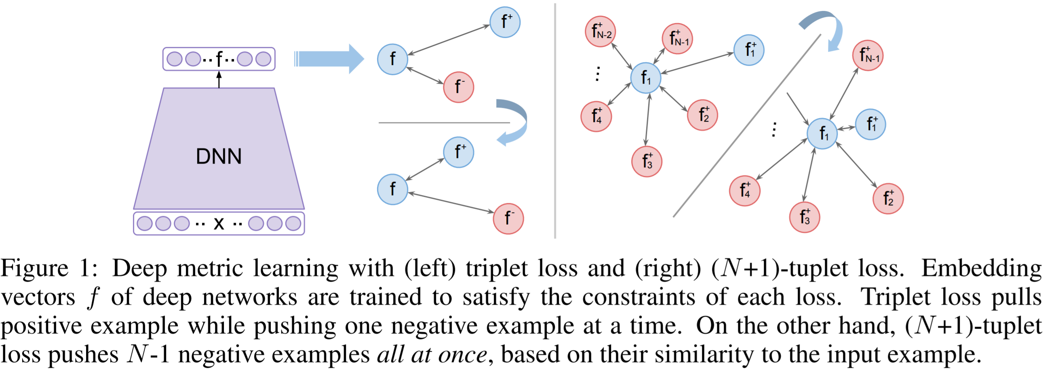
Deep Metric Learning with Multiple Negative Examples

Slide 8
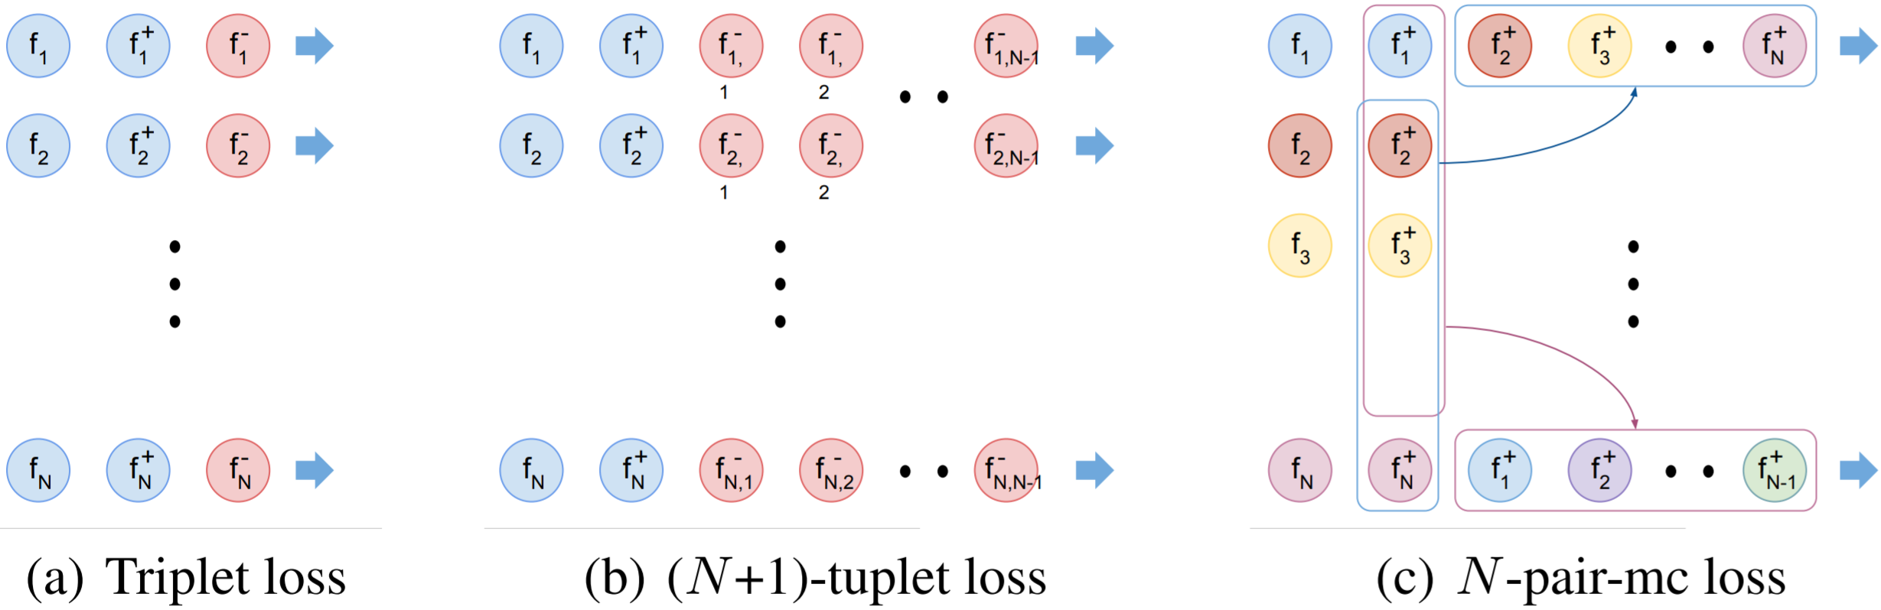
Deep Metric Learning with Multiple Negative Examples

Slide 9
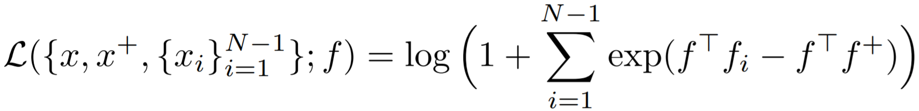
Deep Metric Learning with Multiple Negative Examples : Learning to identify from multiple negative examples
텍스트를 입력하십시오

Slide 10
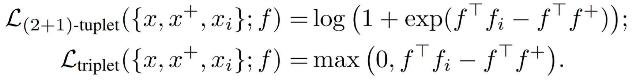
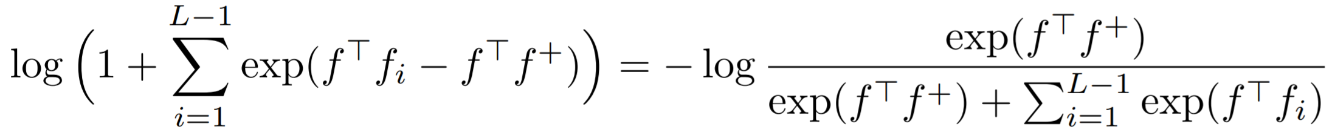
Deep Metric Learning with Multiple Negative Examples : Learning to identify from multiple negative examples
텍스트를 입력하십시오

Slide 11
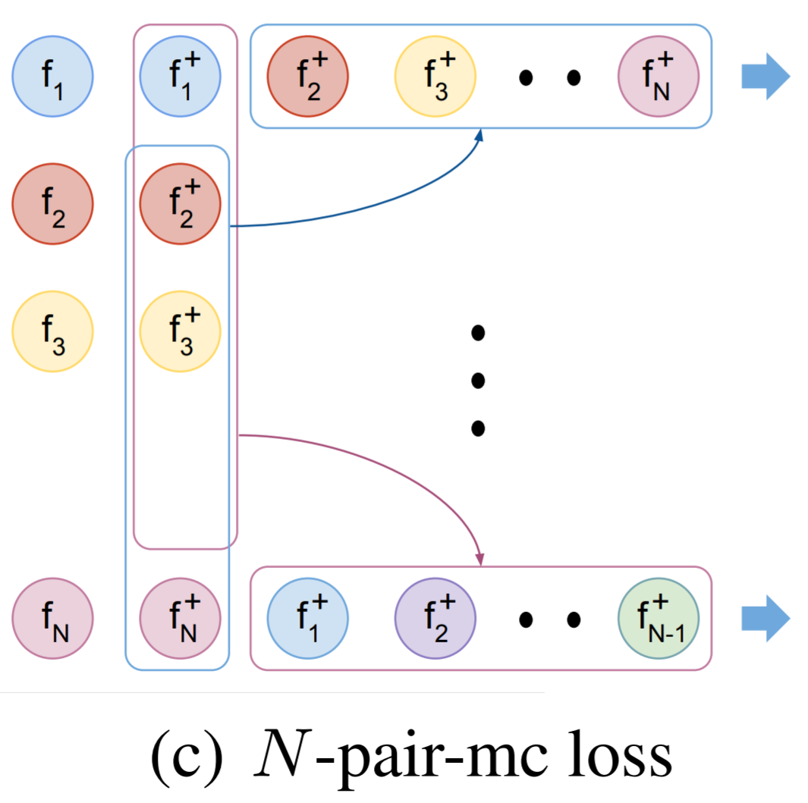
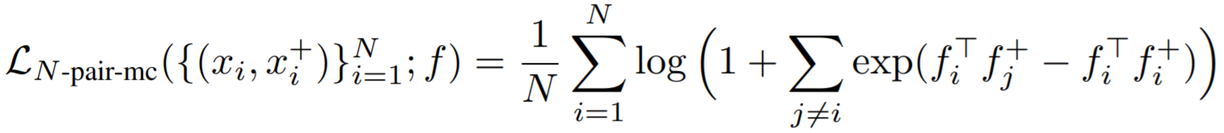
Deep Metric Learning with Multiple Negative Examples : N-pair loss for efficient deep metric learning

Slide 12
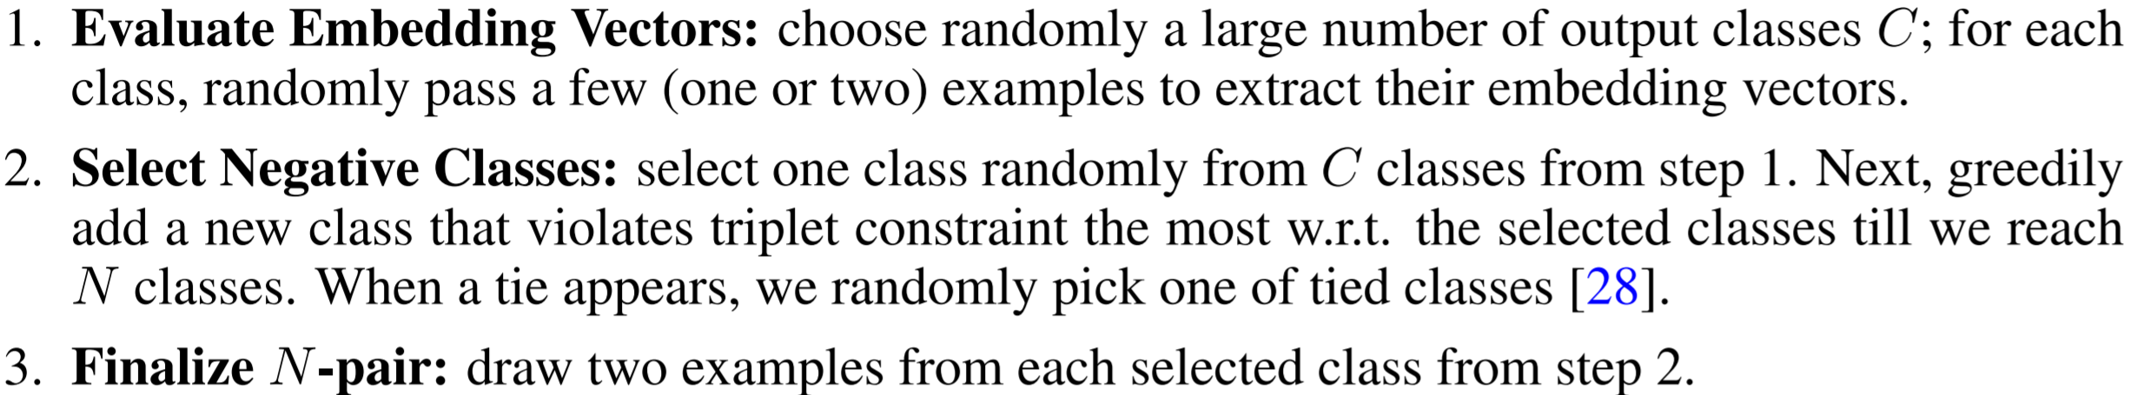
Deep Metric Learning with Multiple Negative Examples : N-pair loss for efficient deep metric learning
Hard Negative class mining

Slide 13
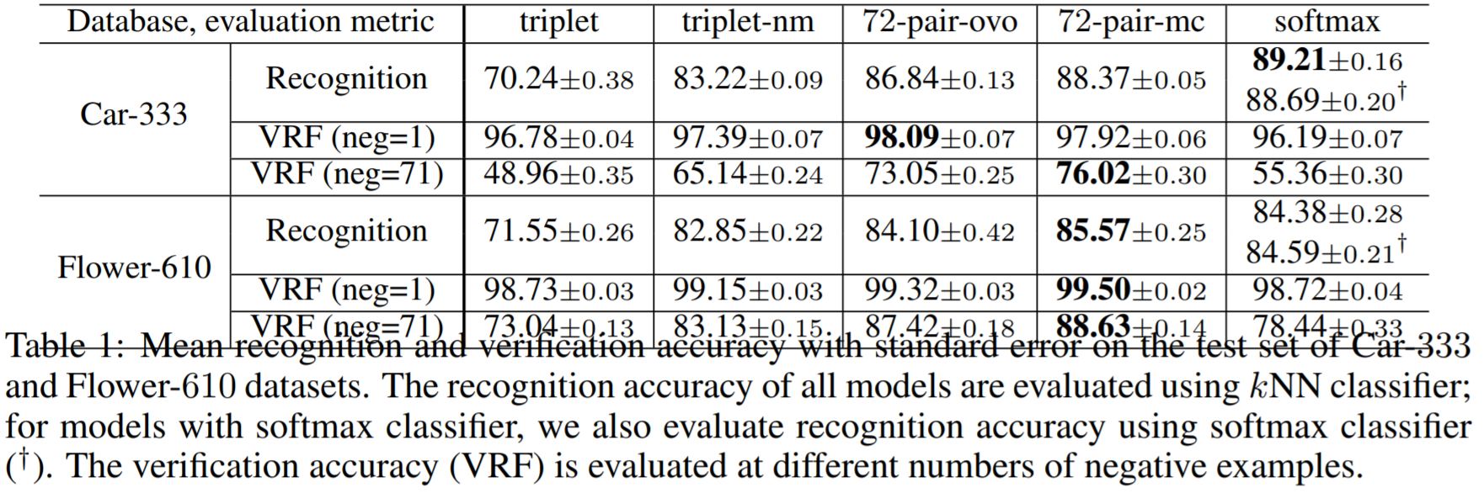
Experimental Results
: Fine-grained visual object recognition and verification

Slide 14
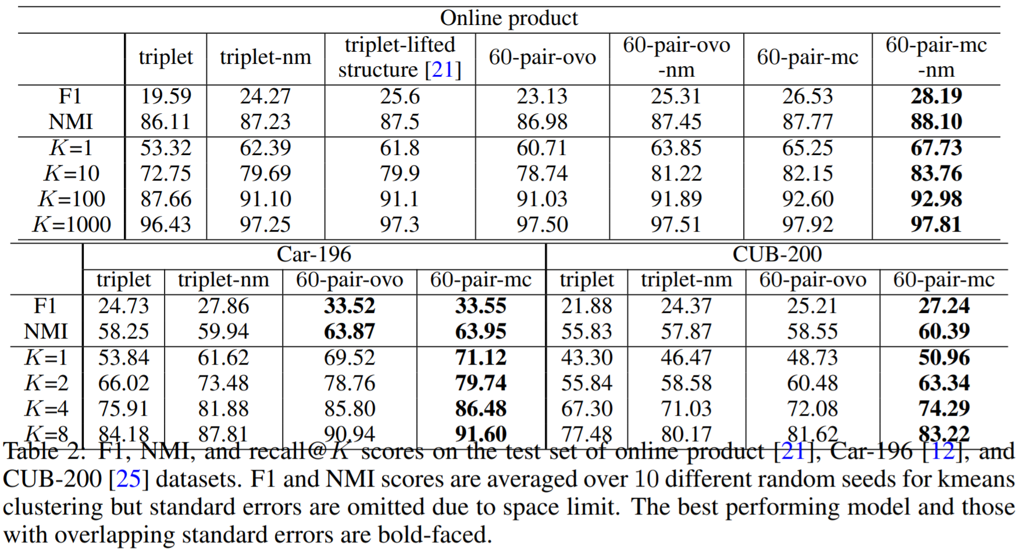
Experimental Results
: Distance metric learning for unseen object recognition

Slide 15
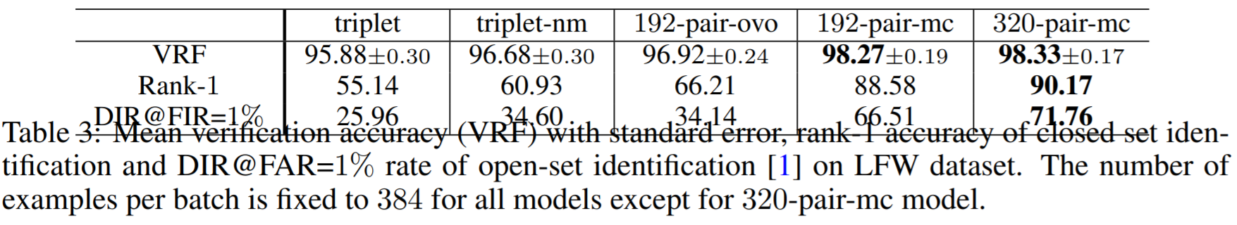
Experimental Results
: Face verification and identification

